Slide 1


Presentation
On
Entertainment and media-online gaming , streaming services,online communicates

Slide 2

Introduction :
Computer networks form the backbone of modern entertainment and media.
They allow people to access games, movies, music, and communication services instantly.
The rise of high-speed internet and 5G has made these services more reliable and accessible.
Entertainment today is global, interactive, and on-demand because of networks.

Slide 3
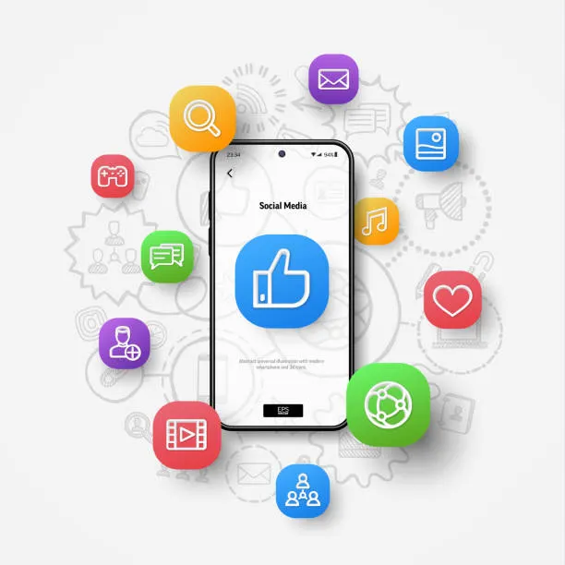
Role of Computer Networks in Media:
Networks enable fast transfer of multimedia content across the world.
Allow collaboration between creators, distributors, and consumers.
Provide cloud storage, real-time sharing, and live content delivery.
Basis for modern platforms like YouTube, Netflix, Twitch, and gaming servers.

Slide 4
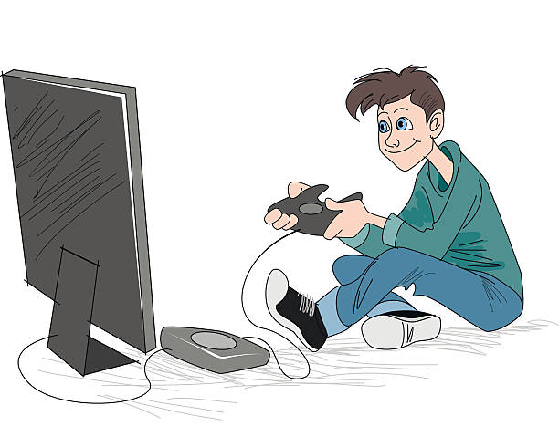
Online Gaming :
Online gaming connects millions of players across the globe in real time.
Key requirement: low latency to avoid lag and smooth gameplay.
Platforms include casual games (Clash of Clans), competitive eSports (Free Fire, PUBG, Fortnite).
Encourages teamwork, competition, and global gaming communities.
Growing industry with tournaments, live streaming, and virtual economies.

Slide 5
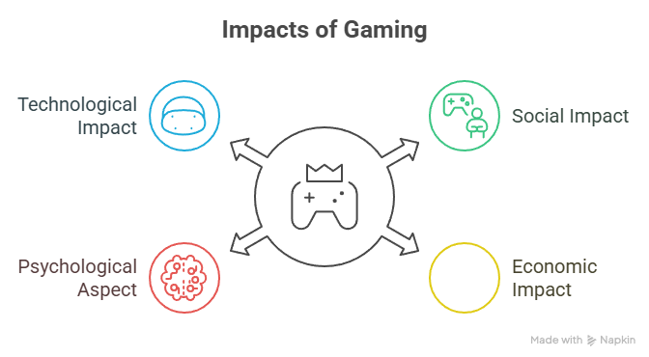

Impact of Online Gaming :
Social Impact: Builds friendships and global communities.
Economic Impact: Creates jobs (developers, streamers, event organizers).
Psychological Aspect: Can improve teamwork and quick thinking but may cause addiction.
Technological Impact: Pushes demand for better graphics, faster networks, and cloud gaming.

Slide 6

Streaming Services :
Streaming delivers movies, TV shows, music, and live events through networks.
Popular platforms: Netflix, Amazon Prime, YouTube, Spotify.
Uses Content Delivery Networks (CDNs) to reduce buffering and improve performance.
Subscription and ad-based models make it accessible to all audiences.
Changed traditional media consumption: “anytime, anywhere, any device.”

Slide 7
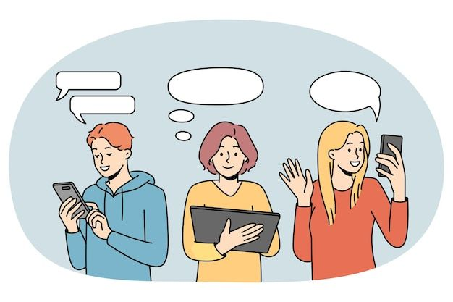
Online Communication :
Real-time communication apps: WhatsApp, Discord, Zoom, Google Meet.
Features: text, voice calls, video conferencing, and group chats.
Used for both social interaction and professional collaboration.
Social media platforms (Instagram, Facebook, Twitter/X) also drive online communication.
Supports digital learning, remote work, and maintaining global connections.

Slide 8

Challenges and Security Issues :
Data Privacy: User data may be collected or misused.
Cyber Threats: Hacking, cheating, and phishing in online platforms.
Network Congestion: High traffic can cause buffering and lag.
Digital Divide: Not all users have equal access to fast internet.

Slide 9
Conclusion :
Computer networks have revolutionized entertainment and communication.
Online gaming, streaming services, and digital communication are everyday essentials.
They rely on fast internet, data security, and scalable infrastructure.
Future developments: Virtual Reality (VR), Augmented Reality (AR), AI-driven media.
Entertainment and media will continue to evolve alongside network technology.

Slide 10
Thank you

